Slide 1

Encapsulation

Slide 2

Exam Objectives
Applying Encapsulation
Apply access modifiers
Apply encapsulation principles to a class

Slide 3
Access Modifiers
Java has 4 access modifiers
Private
Default or package-private
Protected
Public

Slide 4
Restrictions
A top level class can only have 2 types of modifiers namely, public and default. While an inner class can declare itself with any of the four modifiers.
A top level interface or enum can declare any of the possible four access modifiers.

Slide 5
Interface & Enums
Java 9 allows an interface to have private methods. However, fields of an interface are still always public.
The enum constants are always public even when no access modifier is specified. On the other hand, enum constructors are always private. Compiler will generate an error if you try to make them public or protected

Slide 6
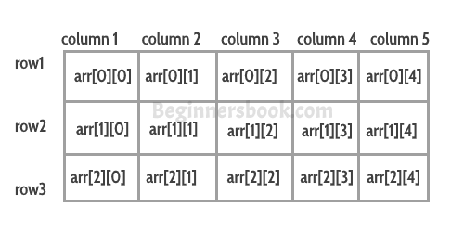
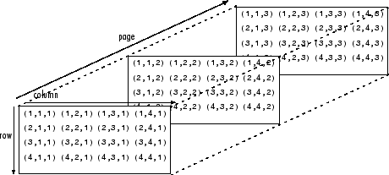
Structure of An Array
Arrays can be single dimensional or multi-dimensional.
Figure on the right shows a two-dimensional and a three-dimensional array.
A multi-dimensional array is just an extension of a 1-D array.
For example ,a 2-D array of dimensions 3*4, can be visualized as a 1-D array of size 3 , with each block pointing to an array of size 4.
Similarly we can extend this analogy to greater dimensions.

Slide 7
Properties of An Array
Each array object has a property named length which can be used to find length of the array.
Whenever we try to access an index in an array which is outside the current range of indices , JVM throws an ArrayIndexOutOfBoundException.
An array of length 0 can be also created. It shall have no containing values. On trying to access any index of such an array, ArrayIndexOutOfBoundException is thrown.
An array once created cannot be changed in size. Values contained in the array can be changed but size of the array itself cannot be changed.
Arrays can be cloned using the clone() method from the object class.

Slide 8
Properties of An Array
As all objects in java extend from Object class , similarly an array object also extends from Object class.
Therefore an array of Object type can hold objects of all types whether it be primitive or reference types.
Since arrays are objects , hence all arrays are assigned default values at the time of creation. All primitive type arrays are assigned default values as zero while non-primitives are assigned null.

Slide 9

Questions ??
a b c

